Slide 1

BSSE -Software Quality Engineering Week-13 Lecture 25 Semester 6- Fall 2020

Slide 2
Project Monitoring and Control
Software Reviews
1

Slide 3
Software Reviews
Introduction
Types of reviews according to formality
Desk check
Peer reviews
Walkthroughs
Inspections
Audits
Checklists
Reporting and follow-up
Other static software analysis techniques

Slide 4
Reviews and testing (Why reviews?)
A software system is more than the code; it is a set of related artifacts; these may contain defects or problem areas that should be reworked or removed; quality-related attributes of these artifacts should be evaluated
Reviews allow us to detect and eliminate errors/defects early in the software life cycle (even before any code is available for testing), where they are less costly to repair
Most problems have their origin in requirements and design; requirements and design artifacts can be reviewed but not executed and tested
A code review usually reveals directly the location of a bug, while
testing requires a debugging step to locate the origin of a bug
Adherence to coding standards cannot be checked by testing

Slide 5
When are reviews needed?
A review is any activity in which a work product is distributed to reviewers who examine it and give feedback.
Reviews are useful not only for finding and eliminating defects, but also for gaining consensus among the project team, securing approval from stakeholders, and aiding in professional development for team members.
Reviews help teams find defects soon after they are injected making them cost less to fix than they would cost if they were found in test.
All work products in a software project should be either reviewed or tested.
Software requirements specifications, schedules, design documents, code, test plans, test cases, and defect reports should all be reviewed.
http://www.stellman-greene.com
4

Slide 6
Technical and management reviews
Technical Reviews - examine work products of the software project (code, requirement specifications, software design documents, test documentation, user documentation, installation procedures) for V&V and QA purposes
Multiple forms: Desk checking, Walkthroughs, Inspections, Peer Reviews, Audits
( Will be discussed as part of the syllabus)
Management Reviews - determine adequacy of and monitor progress or inconsistencies against plans and schedules and requirements
Includes what Ian Somerville calls Progress Reviews
May be exercised on plans and reports of many types (risk management plans, project management plans, software configuration management plans, audit reports, progress reports, V&V reports, etc.)

Slide 7
Components of a review plan
Review goals
Items being reviewed
Preconditions for the review
Roles, team size, participants
Training requirements
Review steps and procedures
Checklists and other related documents to be distributed to participants
Time requirements
Nature of the review log and summary report
Rework and follow-up
(Source: I. Bursntein)

Slide 8
Desk check
Also called self check
Informal review performed by the author of the artifact

Slide 9
Types of Review: Deskchecks
A deskcheck is a simple review in which the author of a work product distributes it to one or more reviewers.
– The author sends a copy of the work product to selected project team members. The team members read it, and then write up defects and comments to send back to the author.
http://www.stellman-greene.com
8

Slide 10
Types of Review: Deskchecks
Unlike an inspection, a deskcheck does not produce written logs which can be archived with the document for later reference.
Deskchecks can be used as predecessors to inspections.
– In many cases, having an author of a work product pass his work to a peer for an informal review will significantly reduce the amount of effort involved in the inspection.
http://www.stellman-greene.com
9

Slide 11
Peer reviews
“I show you mine and you show me yours”
The author of the reviewed item does not participate in the review
Effective technique that can be applied when there is a team (with two or more persons) for each role (analyst, designer, programmer, technical writer, etc.)
The peer may be a senior colleague (senior/chief analyst, senior/chief architect, senior/chief programmer, senior/chief technical writer, etc.)

Slide 12
Walkthroughs
Type of technical review where the producer of the reviewed material serves as the review leader and actually guides the progression of the review (as a review reader)
Traditionally applied to design and code
In the case of code walkthrough, test inputs may be selected and review participants then literally walk through the design or code
Checklist and preparation steps may be eliminated

Slide 13
Inspections
A formal evaluation technique in which software requirements, design, or code are examined in detail by a person or group other than the author to detect faults, violations of development standards, and other problems
Inspections are moderated meetings in which reviewers list all issues and defects they have found in the document and log them so that they can be addressed by the author.
The goal of the inspection is to repair all of the defects so that everyone on the inspection team can approve the work product.
– Commonly inspected work products include software requirements specifications and test plans.
http://www.stellman-greene.com
12

Slide 14
Inspections
Running an inspection meeting:
A work product is selected for review and a team is gathered for an inspection meeting to review the work product.
A moderator is chosen to moderate the meeting.
Each inspector prepares for the meeting by reading the work product and noting each defect.
In an inspection, a defect is any part of the work product that will keep an inspector from approving it.
Discussion is focused on each defect, and coming up with a specific resolution.
It’s the job of the inspection team to do more than just identify the problems; they must also come up with the solutions.
The moderator compiles all of the defect resolutions into an
inspection log
http://www.stellman-greene.com
13

Slide 15
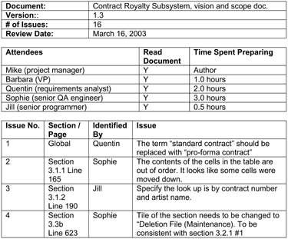
Inspection Log Example
http://www.stellman-greene.com
14

Slide 16
Code Review
A code review is a special kind of inspection in which the team examines a sample of code and fixes any defects in it.
In a code review, a defect is a block of code which does not properly implement its requirements, which does not function as the programmer intended, or which is not incorrect but could be improved
For example, it could be made more readable or its performance could be improved
http://www.stellman-greene.com
15

Slide 17
Code Review
It’s important to review the code which is most likely to have defects. This will generally be the most complex, tricky or involved code.
Good candidates for code review include:
A portion of the software that only one person has the expertise to maintain
Code that implements a highly abstract or tricky algorithm
An object, library or API that is particularly difficult to
work with
Code written by someone who is inexperienced or has not written that kind of code before, or written in an unfamiliar language
Code which employs a new programming technique
An area of the code that will be especially catastrophic if there are defects
http://www.stellman-greene.com
16

Slide 18
A sample general checklist for reviewing software documents
Coverage and completeness
Are all essential items completed?
Have all irrelevant items been omitted?
Is the technical level of each topic addressed properly for this document?
Is there a clear statement of goals for this document?
(Don't forget: more documentation does not mean better documentation)
Correctness
Are there incorrect items?
Are there any contradictions?
Are there any ambiguities?
Clarity and Consistency
Are the material and statements in the document clear?
Are the examples clear, useful, relevant and correct?
Contd/-
(Adapted from Ilene Burnstein, Practical Software Testing, page 327)

Slide 19
Sample general checklist (cont.)
Clarity and Consistency (cont.)
Are the diagrams, graphs and illustrations clear, correct, use the proper notation, effective, in the proper place?
Is the terminology clear and correct?
Is there a glossary of technical terms that is complete and correct?
Is the writing style clear (nonambiguous)?
References and Aids to Document Comprehension
Is there an abstract or introduction?
Is there a well placed table of contents?
Are the topics or items broken down in a manner that is easy to follow
and is understandable?
Is there a bibliography that is clear, complete and correct?
Is there an index that is clear, complete and correct?
Is the page and figure numbering correct and consistent?

Slide 20
A sample specification (or requirements) attributes checklist
Attribute | What to consider
Complete | Is anything missing or forgotten? Is it thorough? Does it include everything necessary to make it stand alone?
Accurate | Is the proposed solution correct? Does it properly define the goal? Are there any errors?
Precise, Unambiguous and Clear | Is the description exact and not vague? Is there a single interpretation? Is it easy to read and understandable?
Consistent | Is the description of the feature written so that it doesn't conflict with itself or other items in the specification?
Relevant | Is the statement necessary to specify the feature? Is there extra information that should be left out? Is the feature traceable to an original customer need?
Feasible | Can the feature be implemented with the available personnel, tools, and resources within the specified budget and schedule?
Code-free | Does the specification stick with defining the product and not the underlying software design, architecture, and code?
Testable | Can the feature be tested? Is enough information provided that a tester could create tests to verify its operation?
(Adapted from: Ron Patton, Software Testing)

Slide 21
A sample supplementary checklist for design reviews
Are the high-level and detailed design consistent with requirements? Do they address all the functional and quality requirements? Is detailed design consistent with high-level design?
Are design decisions properly highlighted and justified and traced back to requirements? Are design alternatives identified and evaluated?
Are design notations (ex: UML), methods (ex: OOD, ATAM) and standards chosen and used adequately?
Are naming conventions being followed appropriately?
Is the system structuring (partitioning into sub-systems, modules, layers, etc.) well defined and explained? Are the responsibilities of each module and the relationships between modules well defined and explained? Do modules exhibit strong cohesion and weak coupling?

Slide 22
A sample supplementary checklist for design reviews
Cont.
Is there a clear and rigorous description of each module interface, both at the syntactic and semantic level? Are dependencies identified?
Have user interface design issues, including standardization, been addressed properly?
Is there a clear description of the interfaces between this system and other software and hardware systems?
Have reuse issues been properly addressed, namely the possible reuse of COTS (commercial off the shelf) components (buy-or-build decision) and in-house reusable components?
Is the system designed so that it can be tested at various levels (unit, integration and system)?
(Adapted from: Ilene Burnstein, page 328-329)

Slide 23
A sample general code review checklist
Design Issues
Does each unit implement a single function?
Are there instances where the unit should he partitioned?
Is code consistent with detailed design?
Does the code cover detailed design?
Data Items
Is there an input validity check?
Arrays-check array dimensions, boundaries, indices.
Variables - are they all defined, initiated? have correct types and scopes been checked?
Are all variables used?
Computations
Are there computations using variables with inconsistent data types?
Are there mixed-mode computations?
Is the target value of an assignment smaller than the right-hand expression?
Is over- or underflow a possibility (division by zero)?
Are there invalid uses of integers or floating point arithmetic?
Are there comparisons between floating point numbers?
Are there assumptions about the evaluation order in Boolean expressions?
Are the comparison operators correct?

Slide 24
A sample general code review checklist
Control Flow Issues
Will the program, module or, unit eventually terminate?
Is there a possibility of an infinite loop, a loop with a premature exit, a loop that never executes?
Interface Issues
Do the number and attributes of the parameters used by a caller match those of the called
routine? Is the order of parameters also correct and consistent in caller and callee?
Does a function or procedure alter a parameter that is only meant as an input parameter?
If there are global variables, do they have corresponding definitions and attributes in all the modules that use them?
Input/output Issues
Have all files been opened for use?
Are all files properly closed at termination?
If files are declared are their attributes correct?
Are EOF or I/O errors conditions handed correctly?
Is I/O buffer size and record size compatible?

Slide 25
A sample general code review checklist (3)
Portability Issues
Is there an assumed character set, and integer or floating point representation?
Are their service calls that mar need to be modified?
Error Messages
Have all warnings and informational messages been checked and used appropriately?
Comments/Code Documentation
Has the code been properly documented? Are there global, procedure, and line comments where appropriate?
Is the documentation clear, and correct, and does it support understanding?
Code Layout and White Space
Has white space and indentation been used to support understanding of code
logic and code intent?
Maintenance
Does each module have a single exit point?
Are the modules easy to change (low coupling and high cohesion)?
(Adapted from: Ilene Burnstein, page 331)

Slide 26
A sample code review checklist for C programs (1)
Data Items
Are all variables lowercase?
Are all variables initialized?
Are variable names consistent, and do they reflect usage?
Are all declarations documented (except for those that are very
simple to understand)?
Is each name used for a singe function (except for loop variable names)?
Is the scope of the variable as intended?
Constants
Are all constants in uppercase?
Are all constants defined with a "#define"?
Are all constants used in multiple files defined in an INCLUDE header file?
Pointers
Are pointers declared properly as pointers?
Are the pointers initialized properly?

Slide 27
A sample code review checklist for C programs (2)
Control
Are if/then, else, and switch statements used clearly and properly?
Strings
Strings should have proper pointers.
Strings should end with a NULL.
Brackets
All curly brackets should have appropriate indentations and be matched
Logic Operators
Do all initializations use an " = " and not an " = ="?
Check to see that all logic operators are correct, for example, use of = / =
=, and ||
Computations
Are parentheses used in complex expressions and are they used properly for specifying precedences?
Are shifts used properly?
(Adapted from: Ilene Burnstein, page. 331)

Slide 28
A sample (end-user) documentation review checklist
What to Check | What to Consider
General Areas
Audience | Does the documentation speak to the correct level of audience, not too novice, not too advanced?
Terminology | Is the terminology proper for the audience? Are the terms used consistently? If acronyms or abbreviations are used, are they standard ones or do they need to be defined? Make sure that your company's acronyms don't accidentally make it through. Are all the terms indexed and cross-referenced correctly?
Content and subject matter | Are the appropriate topics covered? Are any topics missing? How about topics that shouldn't be included, such as a feature that was cut from the product and no one told the manual writer. Is the material covered in the proper depth?
Correctness
Just the facts | Is all the information factually and technically correct? Look for mistakes caused by the writers working from outdated specs or sales people inflating the truth. Check the table of contents, the index, and chapter references. Try the Web site URLs. Is the product support phone number correct? Try it.
Step by step | Read all the text carefully and slowly. Follow the instructions exactly. Assume nothing! Resist the temptation to fill in missing steps; your customers won't know what's missing. Compare your results to the ones shown in the documentation.
Figures and screen captures | Check figures for accuracy and precision. Are they of the correct image and is the image correct? Make sure that any screen captures aren't from prerelease software that has since changed. Are the figure captions correct?
Samples and examples | Load and use every sample just as a customer would. If it's code, type or copy it in and run it. There's nothing more embarrassing than samples that don 't work-and it happens all the time!
Spelling and grammar | In an ideal world, these types of bugs wouldn't mate it through to you. Spelling and grammar checkers are too commonplace not to be used. It's possible, though, that someone forgot to perform the check or that a specialized or technical term slipped through. It's also possible that the checking had to be done manually, such as in a screen capture or a drawn figure. Don't take it for granted.
(Adapted from: Ron Patton, Software Testing, page 195)

Slide 29
Pair Programming
Pair programming is a technique in which two programmers work simultaneously at a single computer and continuously review each others’ work.
Although many programmers were introduced to pair programming as a part of Extreme Programming, it is a practice that can be valuable in any development environment.
Pair programming improves the organization by ensuring that at least two programmers are able to maintain any piece of the software.
http://www.stellman-greene.com
29

Slide 30
Research Findings to Date
Strong anecdotal evidence from industry
“We can produce near defect-free code in less than half the time.”
Empirical Study
Pairs produced higher quality code
15% less defects (difference statistically significant)
Pairs completed their tasks in about half the time
58% of elapsed time (difference not statistically significant)
Most programmers reluctantly embark on pair programming
Pairs enjoy their work more (92%)
Pairs feel more confident in their work products (96%)
© Williams/Kessler 2004

Slide 31
Qualitative Observation (by doctoral student in education)
Pairing is a far superior learning environment
Paired labs – students help each other
Solo labs – students wait 10-30 minutes for help and often sit idle (and frustrated) during this time
Paired students ask “good” questions
Solo students ask “basic” questions
© Williams/Kessler 2004

Slide 32

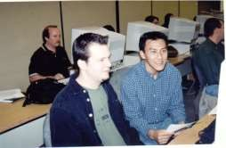
Pair Programming: Summary
Pair programming is an age-old technique
Many are reluctant to try it; the brave souls that do like it!
Expected benefits
Higher product quality
Improved cycle time
Increased programmer satisfaction
Enhanced learning
Ease staff training and transition
Knowledge management
Reduced product risk
Enhanced team building
Distributed pairing a viable alternative
© Williams/Kessler 2004

Slide 33
Higher quality code
Immediate reviews of all code written
Multiple perspectives on how code should work
People from different areas (UI/database, development/testing) working together – no (incorrect) assumptions
Each person learns from the other – increased skills

Slide 34
Faster cycle time
Less temptation/ability to get distracted on non-work things
Less rework due to bad assumptions
Fewer defects slip through, so less rework for defect repair
Less interruption for pair
More communication

Slide 35
Enhanced Trust/Teamwork
People in pairs get to know each other better than people working solo
Better understanding of people’s skills
Shared events = common ground

Slide 36
Knowledge Transfer
Rotation of pairs means lots of combinations
Lots of combinations make knowledge transfer exponential
No one person is indispensible
Fewer assumptions

Slide 37
Enhanced Learning
Each member of a pair has ongoing opportunities to learn from their partner

Slide 38
Why Pair Programming Works
Pair Pressure
Pair Negotiation
Pair Courage
Pair Reviews
Pair Debugging
Pair Learning
Pair Trust

Slide 39
Pair Pressure
Each member doesn’t want to let the other down
Improved adherence to procedures and standards
Motivation to get a task done in a session while partner is available

Slide 40
Pair Negotiation
Working together to get the best solution
Distributed Cognition
Each pair member has
Own set of skills, abilities, outlook.
Shared goal of accomplishing task
Suggested means of means of goal
Brainstorming (building on ideas of others)

Slide 41
Pair Courage
Having a partner agree with a fix or a solution adds confidence to the solution
Two people expressing confusion are more confident to go get the help they need

Slide 42
Pair Reviews
Members of pairs are immediately reviewing code as it is written
Two heads better than one

Slide 43
Pair Debugging
Effective debugging technique is to explain problem to someone else
Talking about problem in a pair can lead to a solution becoming obvious

Slide 44
Pair Learning
Apprenticeship model (beginner acquires learning from observing expert)
No two people are at exact same levels of knowledge on software development
Exposure to different approaches

Slide 45
Pair Trust
See enhanced trust/teamwork slide

Slide 46
Problems in Pair Programming
Unavailability of partners
Scheduling
Experts/Skill Imbalances
Concentration
Disagreements
Overconfidence
Rushing
Not for everyone

Slide 47
Enabling Pair Programming
Accessible workspace
Communication
Standards
Knowledge of people’s specialties
Pair rotation
Group appraisal
Smaller groups

Slide 48
Workspace accessible to both
Display visible to both people
Side by side, not one in front of the other
Keyboard/mouse available to either person

Slide 49
Expectation of communication
Ask to drive
Ask questions
Explain actions taken

Slide 50
Standards
Standard tools reduce learning curve time in pairs
Coding standards assist in both members following the code being written and avoid disagreements on how to write something

Slide 51
Knowledge of people’s specialties
Know who to pair with to achieve benefit in a given situation
If a task overlaps two areas (e.g., UI and database) pair one person from each area

Slide 52
Pair Rotation
No given pair of programmers is the right pair for every situation
Rotation enables knowledge transfer

Slide 53
Group Appraisal
Tasks are now completed by more than one person
Recognizing one person generally ignores contribution from other team members who paired for part or all of the task

Slide 54
Smaller Groups
Large groups benefit from pairing, but lose some of the trust and knowledge transfer effects

Slide 55
Roles
Driver
Actually types or writes down
Explains actions taken
Participates in brainstorming/planning
Navigator
Watches for tactical and strategic defects
Questions
Participates in brainstorming/planning

Slide 56
Navigator Tips
Delay a little to let driver find and correct their own mistakes (particularly typo-level)
If you’re getting bored/falling asleep, ask for the keyboard
If the driver is getting frustrated, ask for the keyboard
If you couldn’t take over at any point, ask questions or ask for the keyboard
Use active listening
Talk
Ask questions

Slide 57
Driver Tips
If navigator bored/falling asleep, give them the keyboard
If you’re tired, pass the keyboard
If you’re frustrated with something, pass the keyboard
Acknowledge navigator
Explain what & why
Talk
Answer questions
Don’t just dictate – brainstorm/design together

Slide 58
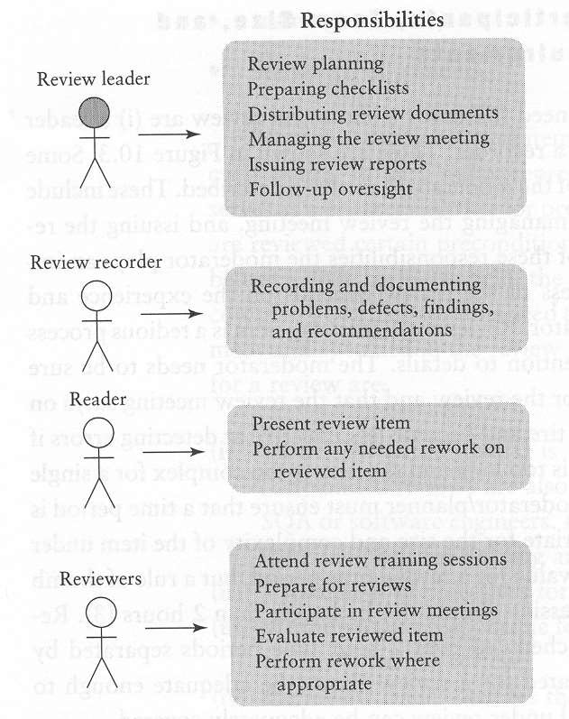

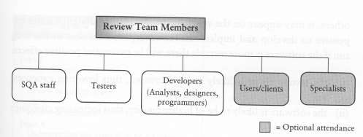

Review roles, responsibilities and attendance
(or moderator)
(may be the author or an “advocate”)
author(s)
(Source: I. Burnstein)

